Slide 1

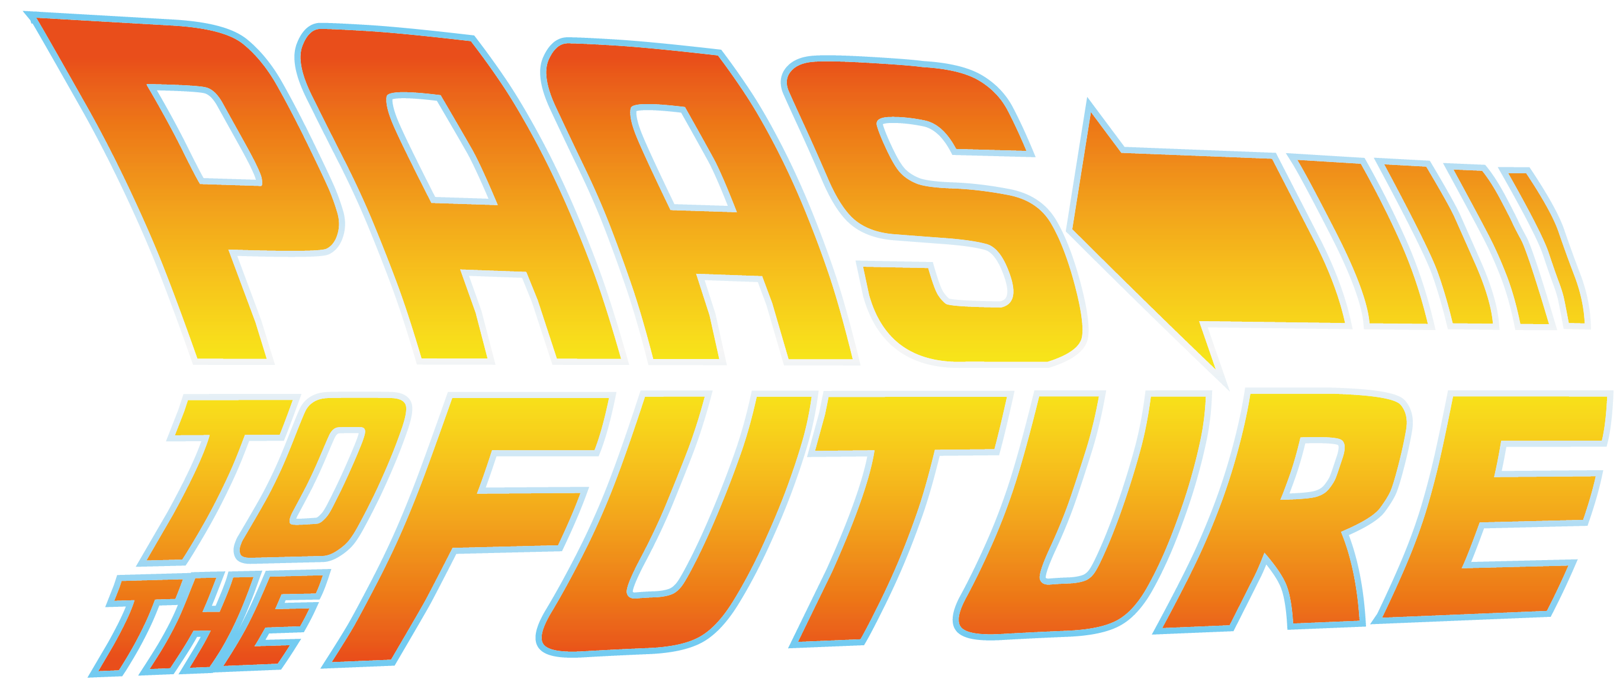
Javier del Valle
Digital Architecture Manager
everis
@JaviValley
Carlos Mendible
Digital Architecture Technical Manager
everis
@cmendibl3

Slide 2


Índice
What do we want in
RED HAT FORUM

Slide 3
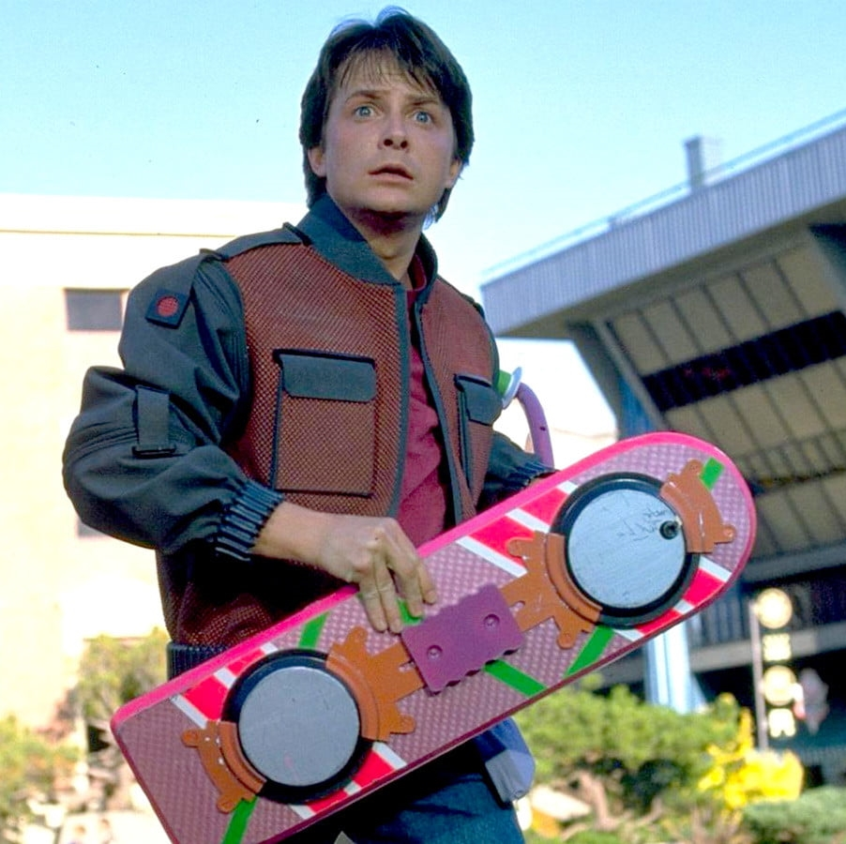
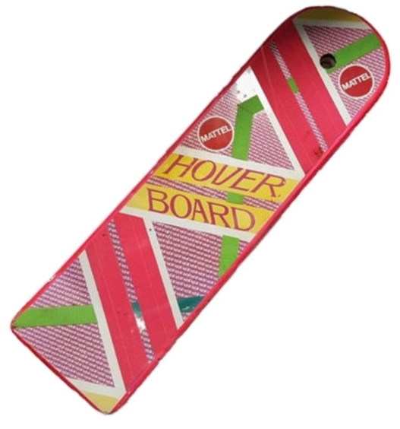

Slide 4


Slide 6
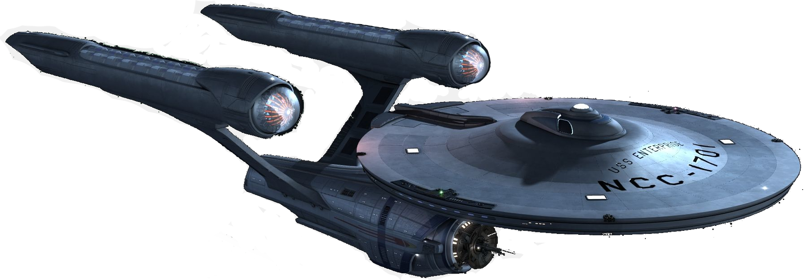
Enterprise
Clients
Clients
Clients
Clients

Slide 7





Business
Clients
Clients
Architecture
Clients
Development
Operation
Clients

Slide 8
Pretty
New & Now
Business
Good
Cheap
Architecture
Development
Operation

Slide 9
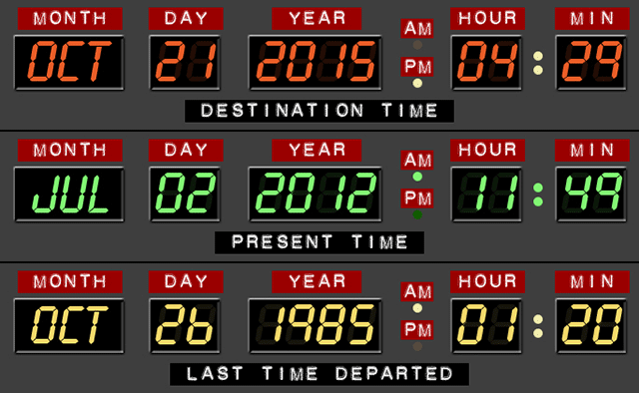
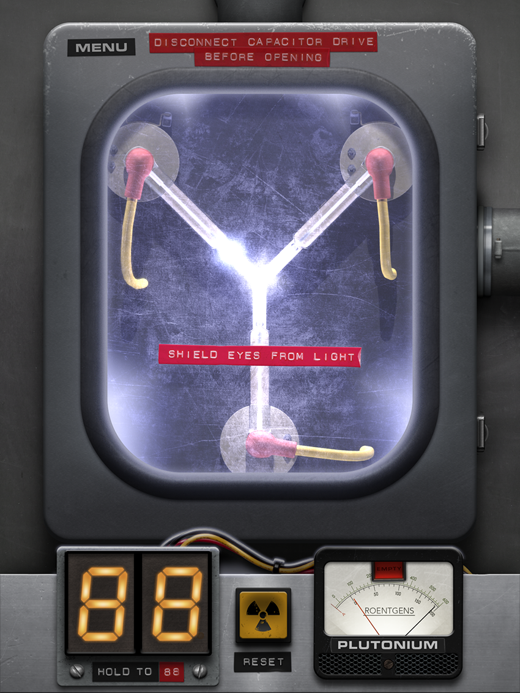
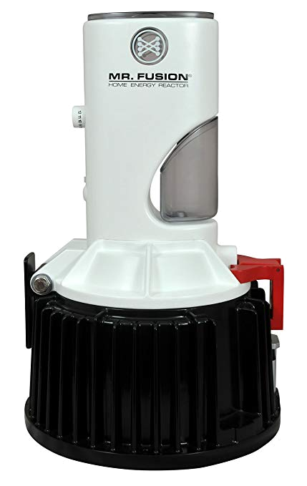
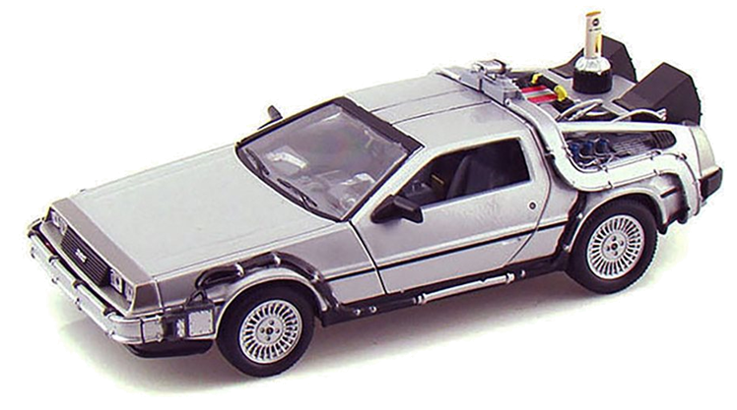
Adapt & Innovate
Time to Market
Business
Resilient
Reduce Costs
Architecture
Development
Operation

Slide 10
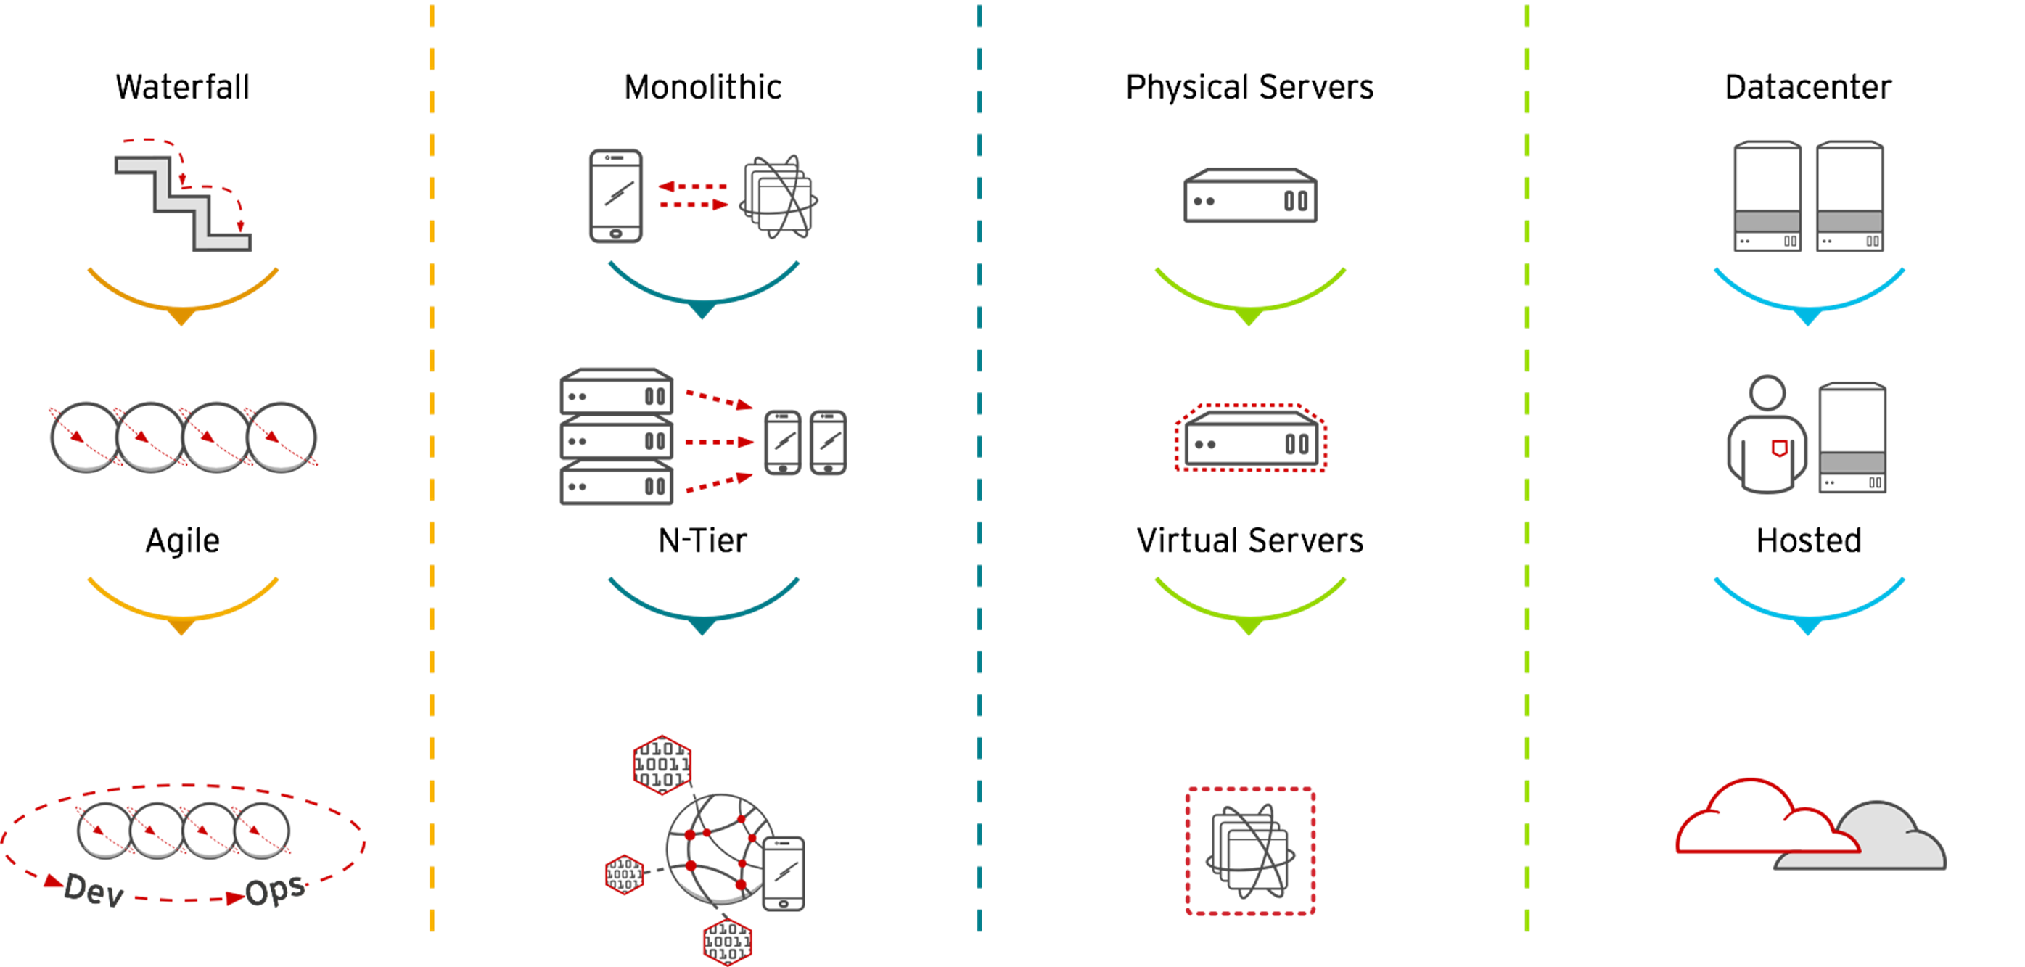
Development Process | Application Architecture | Deployment & Packaging | Application Platform
DevOps | Microservices | Containers | Hybrid Cloud

Slide 11
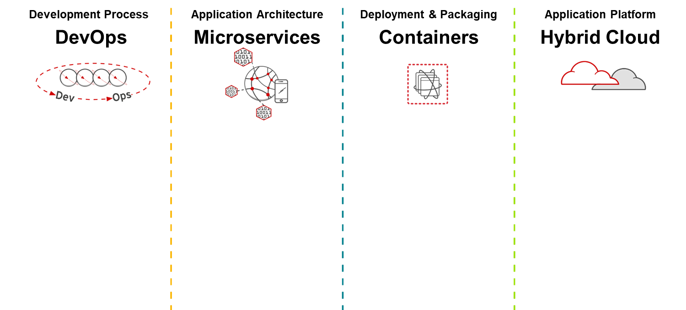
Time to Market
Adapt & Innovate
Resilient
Reduce Cost

Slide 12
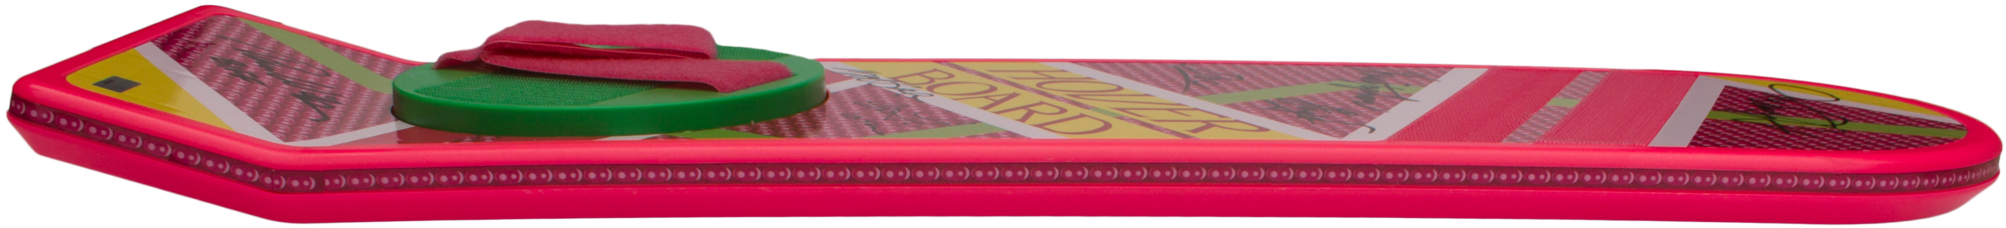
Time to Market
Adapt & Innovate
Resilient
Reduce Cost

Slide 13

Time to Market
Adapt & Innovate
Resilient
Reduce Cost

Slide 14



75
Projects
215
Developers
Average 5-year ROI | 531% | -
Faster application development life cycles | 66% | 36%
Less IT staff time required per application developed | 35% | 17%
Lower IT infrastructure and development platform costs per application | 38% | 13%

Slide 15

Show me
RED HAT FORUM

Slide 17


Slide 18


Slide 19





Slide 20


Slide 21


App
App

Slide 22
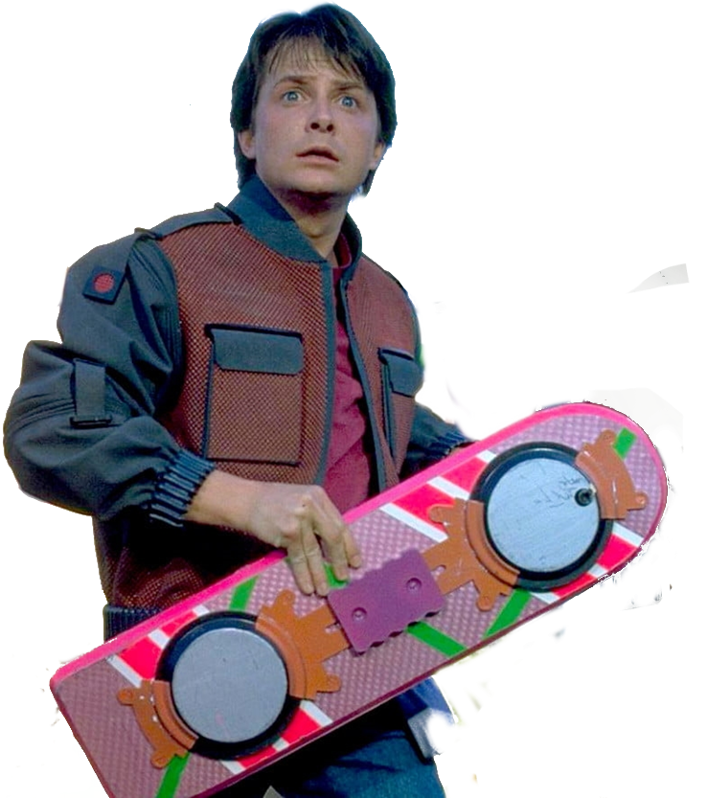
App
App

Slide 23



App
App

Slide 24

RED HAT FORUM

Slide 25
